Slide 1
Deep Reinforcement Learning
Yue Wang

Slide 2
content
What is reinforcement learning
How to solve reinforcement learning
Deep reinforcement learning

Slide 4
A simple example
Agent Environment
State Reward Action Observation Return
Exploration Exploitation

Slide 6
What is reinforcement learning
Machine learning
Supervised learning
Unsupervised learning
Reinforcement learning
y=f(x)
f(x)
y=f(a) r

Slide 7
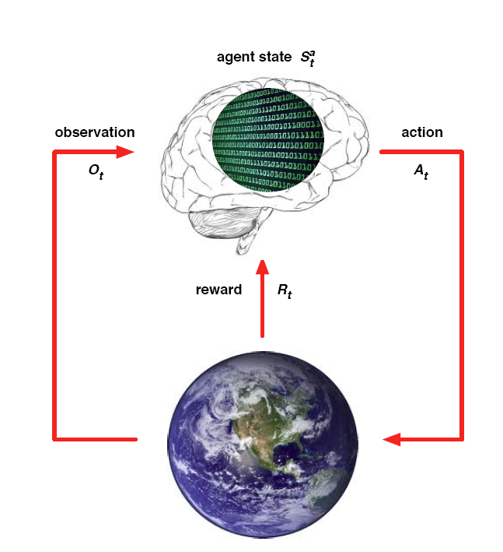
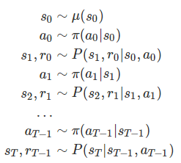
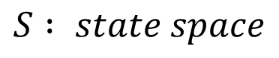
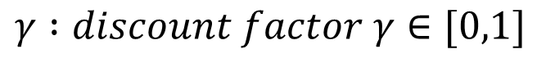
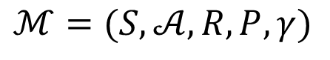
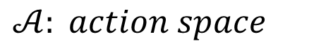
MDP
$$ℳ=(S,𝒜,R,P,γ)$$
$$S : state space$$
$𝒜: action space$
$$R :reward function S×𝒜×S→R$$
$P :transition distribution p(s^{′}|s,a)$
$$γ :discount factor γ∈[0,1]$$

Slide 8
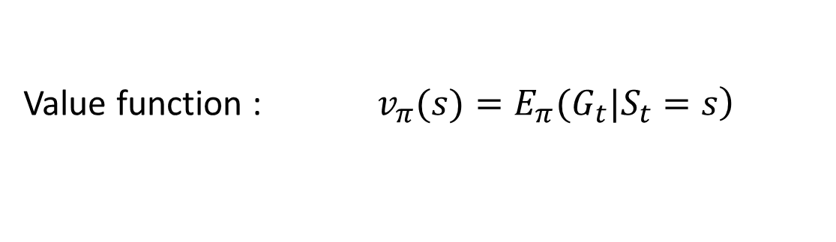
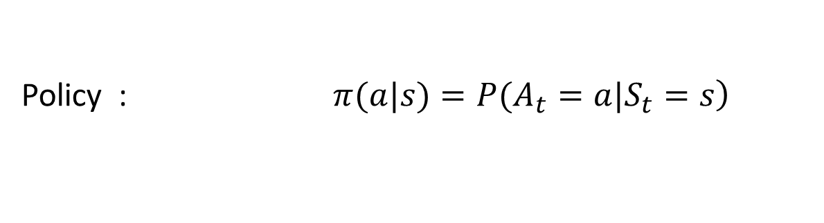
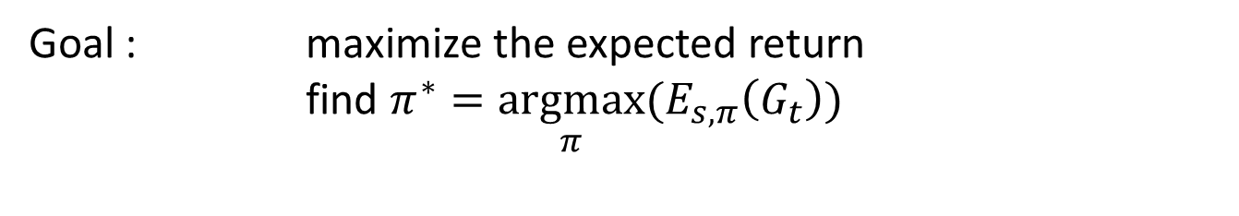
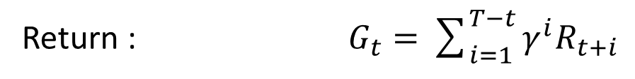
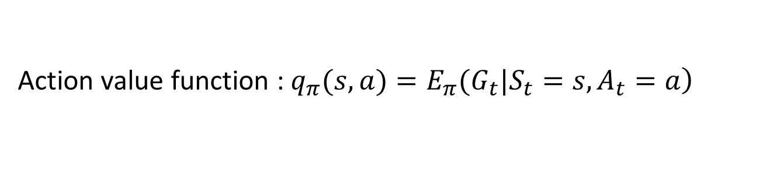
Reinforcement learning
Notation
Return : $G_{t}=\sum_{i=1}^{T−t}{γ^{i}R_{t+i}}$
Policy : $\left.π(a|s)=P(A_{t}=a|S_{t}=s\right)$
Value function : $\left.v_{π}(s)=E_{π}(G_{t}|S_{t}=s\right)$
Action value function : $\left.q_{π}(s,a)=E_{π}(G_{t}|S_{t}=s,A_{t}=a\right)$
Goal : maximize the expected return
find $π^{∗}=\underset{π}{argmax}(E_{s,π}\left(G_{t}\right))$

Slide 9
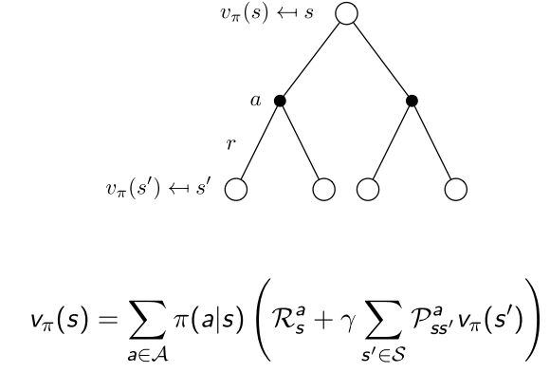
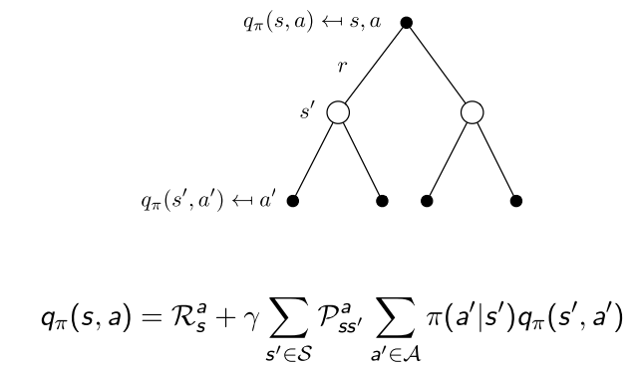
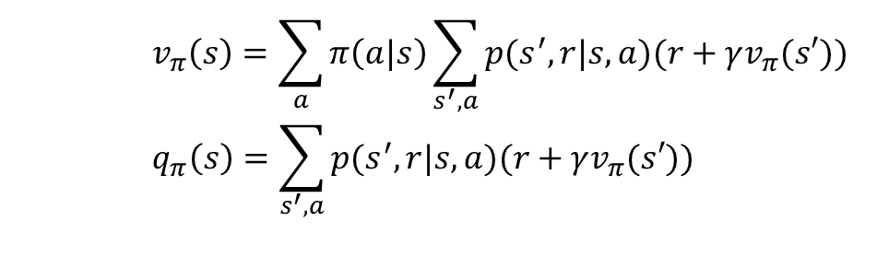
Value function
$$v_{π}\left(s\right)=\sum_{a}{π\left(a|s\right)\sum_{s^{′},a}{p(s^{′},r|s,a)(r+γv_{π}(s′))}}$$
$$q_{π}\left(s\right)=\sum_{s^{′},a}{p(s^{′},r|s,a)(r+γv_{π}(s′))}$$

Slide 10
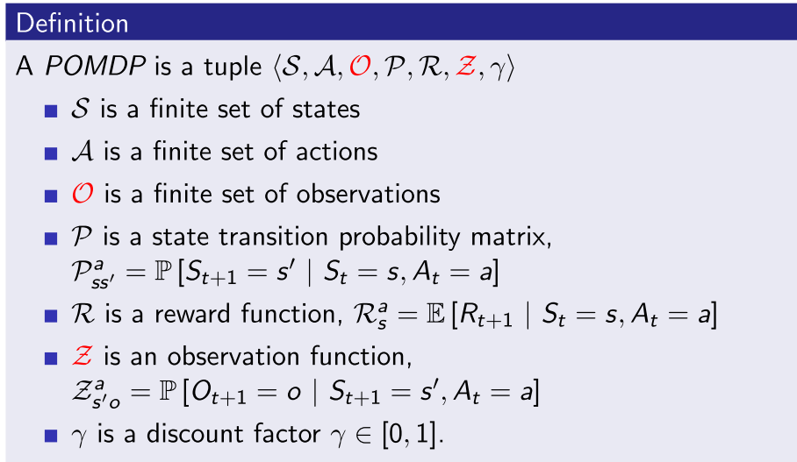
POMDP

Slide 11
POMDP
Markov Models |  | Do we have control over the state transitions?
 |  | No | Yes
Are the states completely observable? | Yes | Markov Chain | MDP
 | No | HMM Hidden Markov Model | POMDP Partially Observable Markov Decision Process

Slide 13
Algorithms
Value function based
DP
Policy iteration
Value iteration
MC
On policy
Off policy
TD
Sarsa
Q-learning
Policy Gradient
Reinforce
Actor-Critic

Slide 14
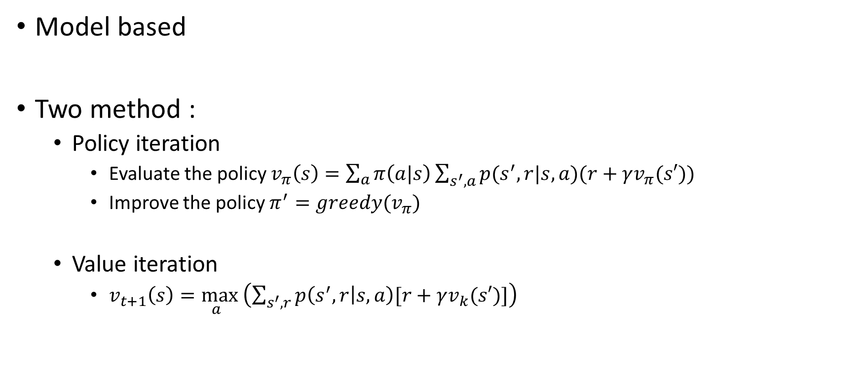
Algorithms DP (Dynamic Programming)
Model based
Two method :
Policy iteration
Evaluate the policy $v_{π}\left(s\right)=\sum_{a}{π\left(a|s\right)\sum_{s^{′},a}{p(s^{′},r|s,a)(r+γv_{π}(s′))}}$
Improve the policy $π^{′}=greedy(v_{π})$
Value iteration
$v_{t+1}\left(s\right)=\max_{a }\left(\sum_{s^{′},r}{p\left(s^{′},r | s,a\right)[r+γv_{k}(s′)]}\right)$

Slide 15
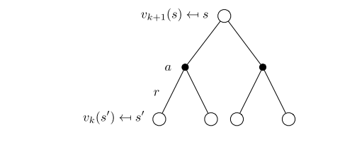
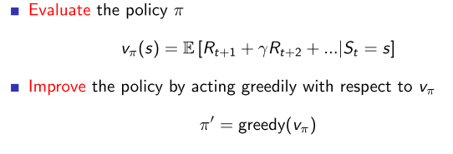
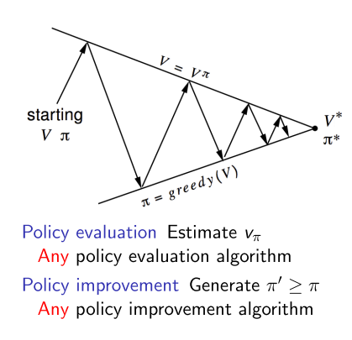
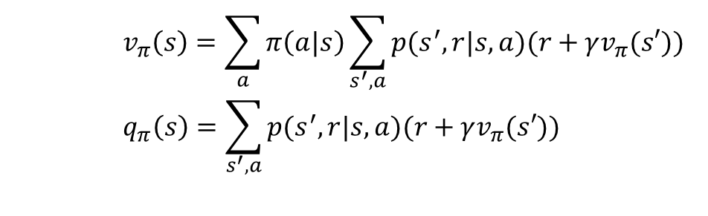
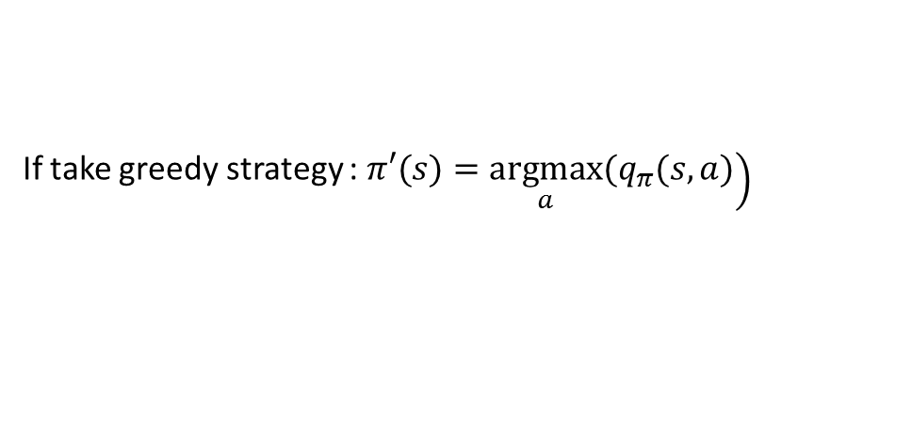
Policy iteration
Evaluate
Improve
$$v_{π}\left(s\right)=\sum_{a}{π\left(a|s\right)\sum_{s^{′},a}{p(s^{′},r|s,a)(r+γv_{π}(s′))}}$$
$$q_{π}\left(s\right)=\sum_{s^{′},a}{p(s^{′},r|s,a)(r+γv_{π}(s′))}$$
If take greedy strategy : $\left.π′(s)=\underset{a}{argmax}(q_{π}(s,a)\right)$

Slide 16
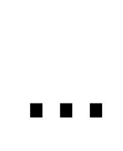
An example
0 | 0 | 0 | 0
0 | 0 | 0 | 0
0 | 0 | 0 | 0
0 | 0 | 0 | 0
0 | -1 | -1 | -1
-1 | -1 | -1 | -1
-1 | -1 | -1 | -1
-1 | -1 | -1 | 0
0 | -1.7 | -2.0 | -2.0
-1.7 | -2.0 | -2.0 | -2.0
-2.0 | -2.0 | -2.0 | -1.7
-2.0 | -2.0 | -1.7 | 0
0 | -2.4 | -2.9 | -3.0
-2.4 | -2.9 | -3.0 | -2.9
-2.9 | -3.0 | -2.9 | -2.4
-3.0 | -2.9 | -2.4 | 0
0 | -6.1 | -8.4 | -9.0
-6.1 | -7.7 | -8.4 | -8.4
-8.4 | -8.4 | -7.7 | -6.1
-9.0 | -8.4 | -6.1 | 0
$$…$$
One step convergence !

Slide 17
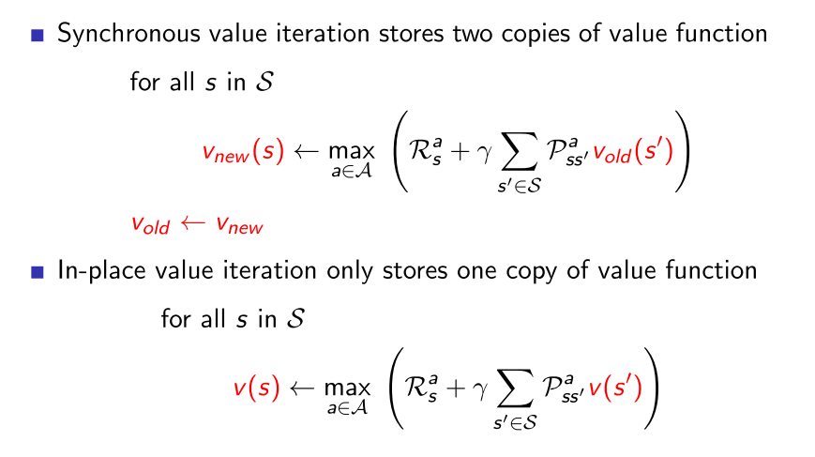
Value iteration

Slide 18
An example
0 | 0 | 0 | 0
0 | 0 | 0 | 0
0 | 0 | 0 | 0
0 | 0 | 0 | 100
0 | -1 | -1 | -1
-1 | -1 | -1 | -1
-1 | -1 | -1 | 99
-1 | -1 | 99 | 100
0 | -1 | -2 | -2
-1 | -2 | -2 | 98
-2 | -2 | 98 | 99
-2 | 98 | 99 | 100
0 | -1 | -2 | 97
-1 | -2 | 97 | 98
-2 | 97 | 98 | 99
97 | 98 | 99 | 100
0 | -1 | 96 | 97
-1 | 96 | 97 | 98
96 | 97 | 98 | 99
97 | 98 | 99 | 100
0 | 95 | 96 | 97
95 | 96 | 97 | 98
96 | 97 | 98 | 99
97 | 98 | 99 | 100
Convergence !

Slide 19
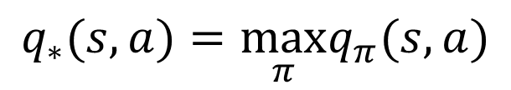
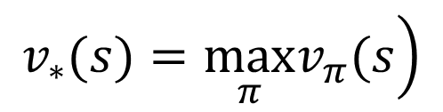
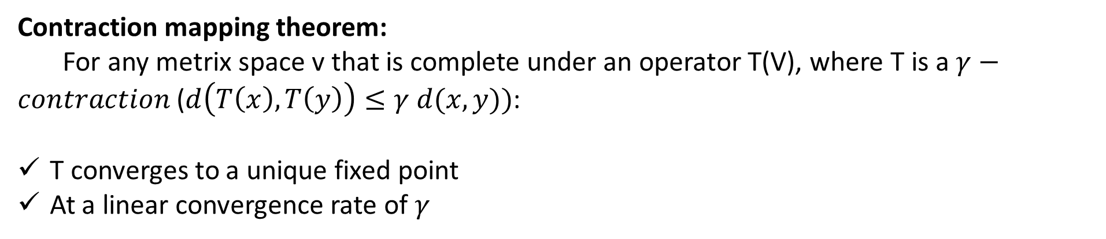
Optimal value function
$$\left.v_{∗}(s)=\max_{π}v_{π}(s\right)$$
$$q_{∗}(s,a)=\max_{π}q_{π}(s,a)$$
$$v_{∗}(s)=\max_{a}E\left[R_{t+1}+γv_{∗}\left(S_{t+1}\right) | S_{t}=s,A_{t}=a\right]=\max_{a}\sum_{s^{′},r}{\left.p(s^{′},r|s,a)[r+γv_{∗}(s^{′})\right]}$$
$$\left.q_{∗}(s,a)=E[R_{t+1}+γ\max_{a′}q_{∗}(S_{t+1},a′)|S_{t}=s,A_{t}=a\right]\text{=}\sum_{s^{′},r}{\left.p(s^{′},r|s,a)[r+γ\max_{a}q_{∗}(s^{′},a′)\right]}$$
Contraction mapping theorem:
For any metrix space v that is complete under an operator T(V), where T is a $γ−contraction$ ($d\left(T\left(x\right),T\left(y\right)\right)≤γ d(x,y))$:
T converges to a unique fixed point
At a linear convergence rate of $γ$

Slide 20
Algorithms MC (Monte Carlo)
Model free
Episodic MDP
value = mean return
On policy and off policy !

Slide 21
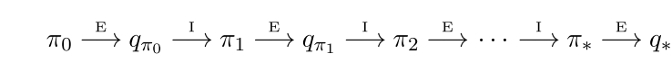
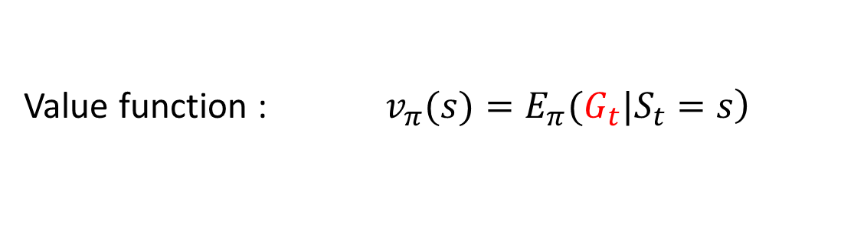
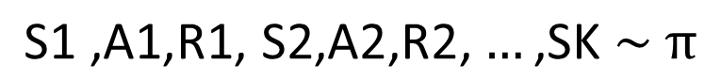
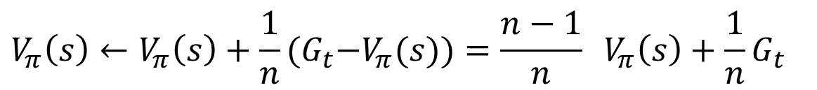
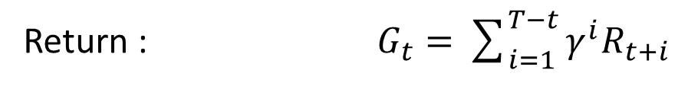
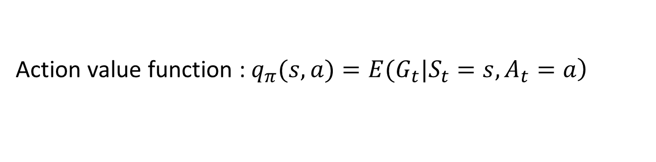
Initial MC algorithms
Return : $G_{t}=\sum_{i=1}^{T−t}{γ^{i}R_{t+i}}$
Value function : $\left.v_{π}(s)=E_{π}(G_{t}|S_{t}=s\right)$
Action value function : $\left.q_{π}(s,a)=E(G_{t}|S_{t}=s,A_{t}=a\right)$
$$\text{S}\text{1 ,}\text{A}\text{1,}\text{R}\text{1, }\text{S}\text{2,}\text{A}\text{2,}\text{R}\text{2,}…\text{,}\text{SK} \sim π$$
E for policy evaluation
I for policy improvement
$$V_{π}\left(s\right)←V_{π}\left(s\right)+\frac{1}{n}{(G}_{t}−V_{π}(s))=\frac{n−1}{n} V_{π}\left(s\right)+\frac{1}{n}G_{t}$$
Is there any problem ? Recall the simple game before we start.
Trade off between exploration and exploitation

Slide 22
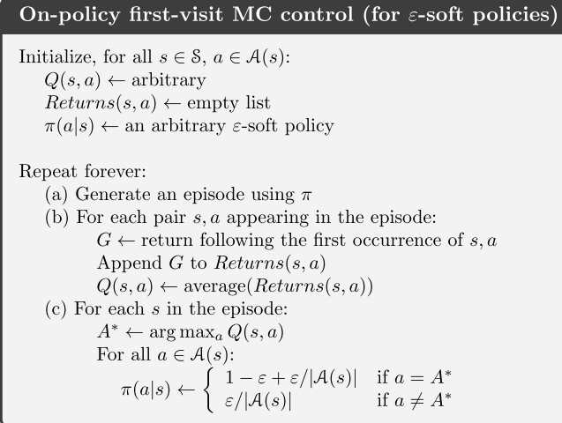
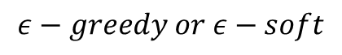
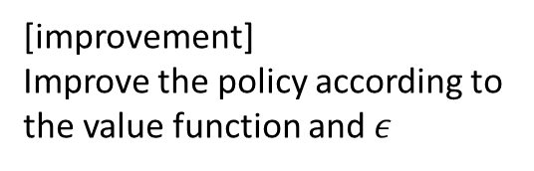
On policy and off policy
$$ε−greedy or ε−soft$$
[evaluation]
Compute the value function according to the expectation
[improvement]
Improve the policy according to the value function and $ε$

Slide 23
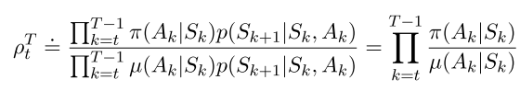
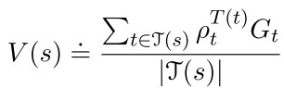
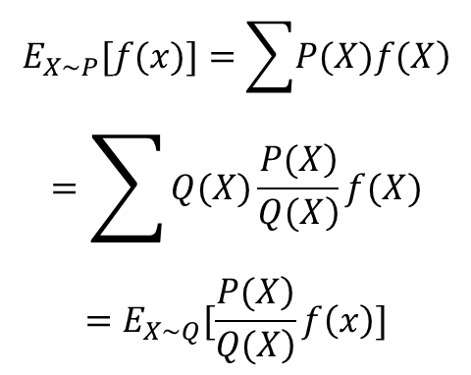
On policy and off policy
Behavior policy and Target policy are different
Through importance sampling( Measure Transformation ) to adjust the expectation
$$\begin{matrix}E_{X\sim P}[f(x)]=\sum{\left.P(X)f(X\right)} \\ =\sum{Q(X)\frac{\left.P(X\right)}{\left.Q(X\right)}f(X}) \\ =E_{X\sim Q}[\frac{\left.P(X\right)}{\left.Q(X\right)}f\left(x\right)]\end{matrix}$$

Slide 24
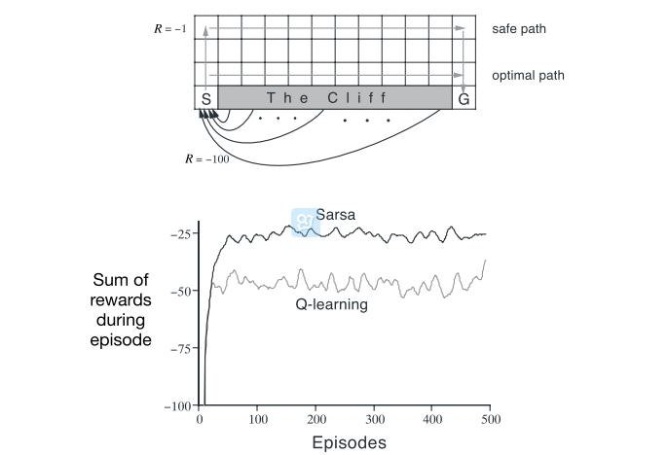
An example

Slide 25
Algorithms TD (Temporal Difference)
Model free
Three important methods :
TD(0)
Sarsa
Q-leaning

Slide 26
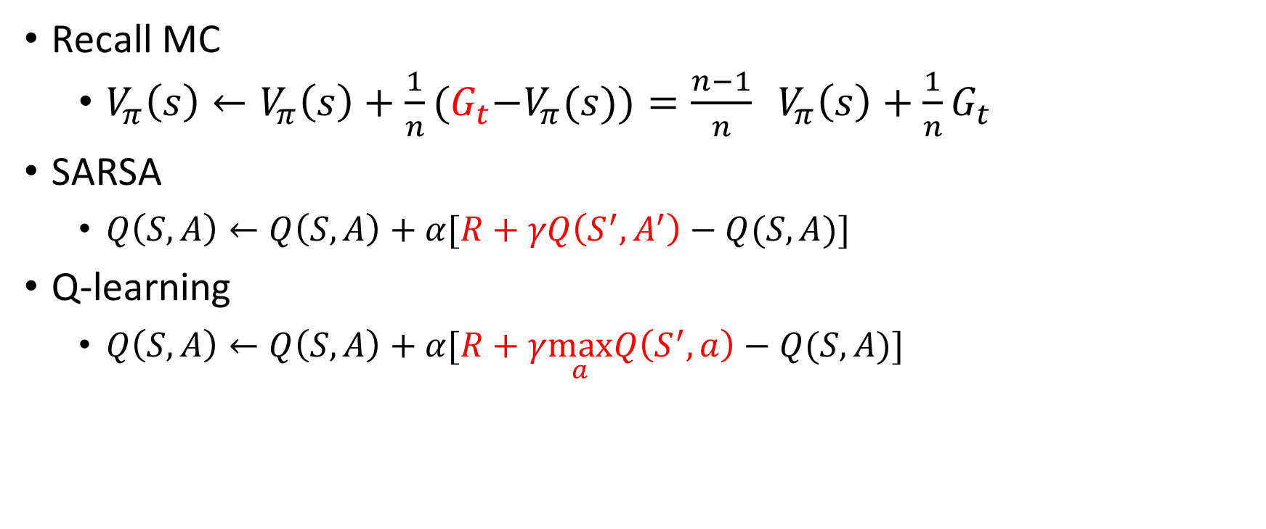
TD
Recall MC
$V_{π}\left(s\right)←V_{π}\left(s\right)+\frac{1}{n}{(G}_{t}−V_{π}(s))=\frac{n−1}{n} V_{π}\left(s\right)+\frac{1}{n}G_{t}$
SARSA
$Q\left(S,A\right)←Q\left(S,A\right)+α[R+γQ\left(S^{′},A^{′}\right)−Q(S,A)]$
Q-learning
$Q\left(S,A\right)←Q\left(S,A\right)+α[R+γ\max_{a}Q\left(S^{′},a\right)−Q(S,A)]$

Slide 27
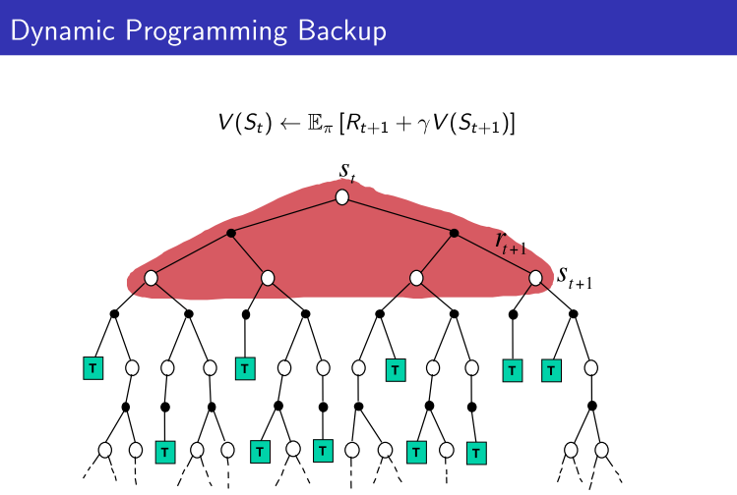
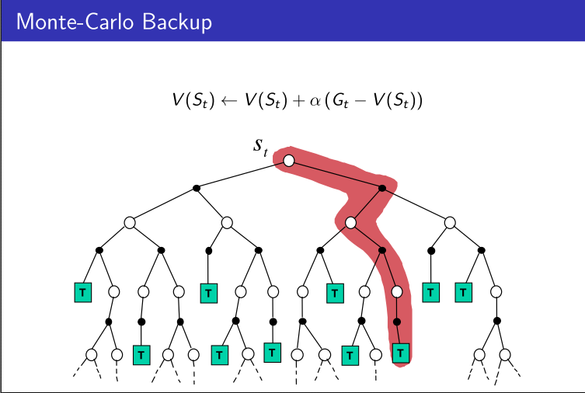
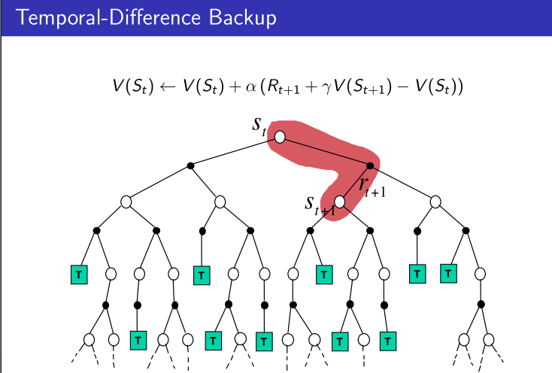
 | Markov Property | Bootstrapping | sampling
DP | Yes | Yes | No
MC | No | No | Yes
TD | Yes | Yes | Yes

Slide 28
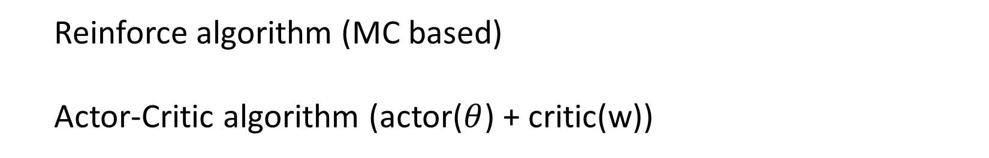
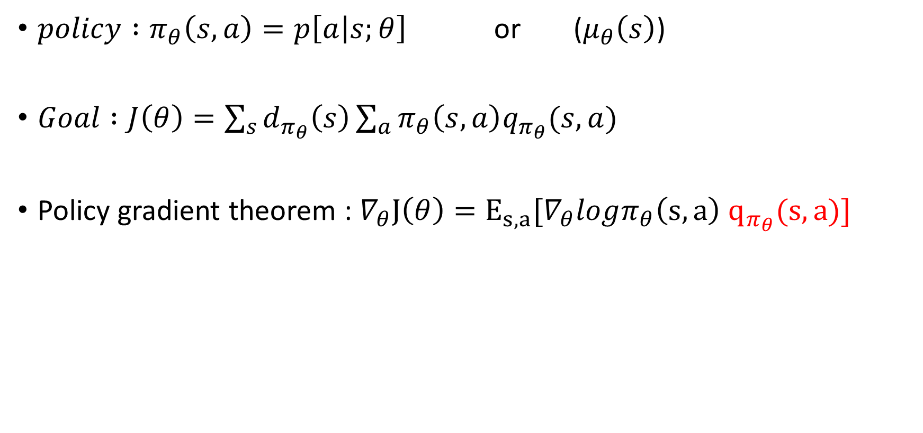
Policy Gradient
$policy :π_{θ}\left(s,a\right)=p\left[a | s;θ\right]$ or ($μ_{θ}\left(s\right)$)
$Goal :J\left(θ\right)=\sum_{s}{d_{π_{θ}}\left(s\right)\sum_{a}{π_{θ}\left(s,a\right)q_{π_{θ}}(s,a)}}$
Policy gradient theorem : $∇_{θ}J\left(θ\right)=E_{s,a}[∇_{θ}logπ_{θ}\left(s,a\right) q_{π_{θ}}(s,a)]$
Reinforce algorithm (MC based)
Actor-Critic algorithm (actor($θ$) + critic(w))

Slide 30
Problems
Recall :
Value function and policy
Function approximation
Policy improve need max operation vs Continues control
Policy gradient

Slide 31
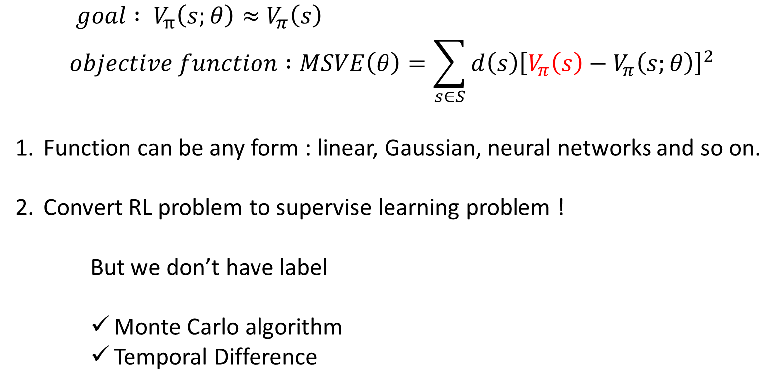
Function approximation
$$goal : V_{π}\left(s;θ\right)≈V_{π}\left(s\right)$$
$$objective function :MSVE\left(θ\right)=\sum_{s∈S}{d\left(s\right){\left[V_{π}\left(s\right)−V_{π}\left(s;θ\right)\right]}^{2}}$$
Function can be any form : linear, Gaussian, neural networks and so on.
Convert RL problem to supervise learning problem !
But we don’t have label
Monte Carlo algorithm
Temporal Difference

Slide 32
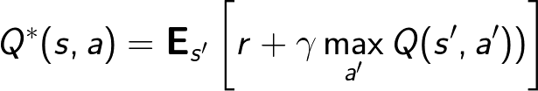
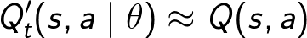
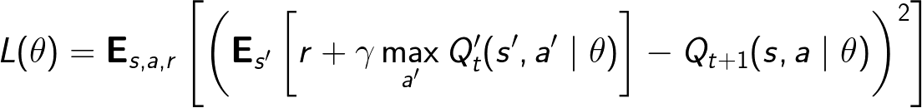
An example
$$Q learning : Q\left(S,A\right)←Q\left(S,A\right)+α[R+γ\max_{a}Q\left(S^{′},a\right)−Q(S,A)]$$

Slide 33
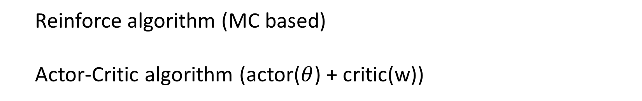

Policy Gradient
$policy :π_{θ}\left(s,a\right)=p\left[a | s;θ\right]$
$Goal :J\left(θ\right)=\sum_{s}{d^{π_{θ}}\left(s\right)\sum_{a}{π_{θ}\left(s,a\right)R_{s}^{a}}}$
Policy gradient theorem :
$$∇_{θ}J\left(θ\right)=\iint_{s,a}{d^{π_{θ}}(s)π_{θ}\left(s,a\right)∇_{θ}logπ_{θ}(s,a){(Q}^{π_{θ} }\left(s,a\right))dsda}$$
$$=E[∇_{θ}logπ_{θ}\left(s,a\right) {(Q}^{π_{θ} }\left(s,a\right))]$$
Reinforce algorithm (MC based)
Actor-Critic algorithm (actor($θ$) + critic(w))

Slide 35

Deep Neural Network

Slide 36

Deep Neural Network

Slide 37
Deep reinforcement learning
Improvement of RL
Deep neural network to approximate functions in RL
Express abstract and complex function relation
End to end task
Implementation of DRL
The definition of objection
Deep value function (DQN)
Deep policy approximation (DDPG)
Problems bring by deep learning
No convergence guarantee
Train slowly

Slide 38



An example (QDN)

Slide 39


An example (DDPG) (deterministic deep policy gradient)
Input:
state
Nonlinear transform:
Parameter $θ^{π}$
Output:
action
Input:
action
Nonlinear transform :
Parameter $θ^{Q}$
Output:
Q value
Input:
state
Gradient descent

Slide 40
Convergence issue
Some trick
Asynchronous
Variance reduce
others

Slide 41

Some trick
Use experience replay
Store transition ${(s}_{t},a_{t},r_{t+1},s_{t+1})$ in D
Randomly sample mini-batch
Use mini-batch to optimize the target
Freeze target Q-network
$L\left(w\right)=E[{\left(R+γQ\left(S^{′},a^{′},w\right)−Q\left(S,a,w\right)\right)}^{2}]$
$L\left(w\right)=E[{\left(R+γQ\left(S^{′},a^{′},w^{−}\right)−Q\left(S,a,w\right)\right)}^{2}]$
Double Q-learning
$Y_{t}^{Q}=R_{t+1}+γQ(S_{t+1},argmax_{a}Q\left(S_{t+1},a;θ_{t}\right);θ_{t})$
$Y_{t}^{DoubleQ}=R_{t+1}+γQ(S_{t+1},argmax_{a}Q\left(S_{t+1},a;θ_{t}\right);{θ′}_{t})$
Clip rewards or normalize network
Advantage decompose
$Q\left(S,A\right)=V\left(S\right)+A(S,A)$

Slide 42

Asynchronous
Mnih, Volodymyr, et al. "Asynchronous methods for deep reinforcement learning." arXiv preprint arXiv:1602.01783 (2016).

Slide 43

Variance reduce
Zhao, Tingting, et al. "Analysis and improvement of policy gradient estimation." Advances in Neural Information Processing Systems. 2011.
Reinforce
PGPE : $J\left(ρ\right)=\iint_{s,a}{π_{θ}\left(s,a\right)p\left(θ | ρ\right)Q^{π_{θ}}}\left(s,a\right)dsda$
Reinforce with baseline
$∇_{θ}J\left(θ\right)=E[∇_{θ}logπ_{θ}\left(s,a\right) {(Q}^{π_{θ} }\left(s,a\right)−b\left(s\right))]=\iint_{s,a}{d^{π_{θ}}(s)π_{θ}\left(s,a\right)∇_{θ}logπ_{θ}(s,a){(Q}^{π_{θ} }\left(s,a\right)−b\left(s\right))dsda}$
Greensmith, Evan, Peter L. Bartlett, and Jonathan Baxter. "Variance reduction techniques for gradient estimates in reinforcement learning."Journal of Machine Learning Research 5.Nov (2004): 1471-1530.

Slide 44

My thinking
Is there any theoretical analysis of the convergence about RL algorithms and functional approximation？

Slide 45
My thinking
Many tricks and improvements make algorithms work for real task.
It seems most of them only have intuitive explanation.
Such as advantage decomposition.
Can we give some theoretical explanation about these tricks and improvements.

Slide 46
My thinking
Analysis
Understand
Improve

Slide 47
Some reference
Tutorial video
http://videolectures.net/rldm2015_silver_reinforcement_learning/
http://www0.cs.ucl.ac.uk/staff/D.Silver/web/Teaching.html
Book
Reinforcement learning: An introduction http://people.inf.elte.hu/lorincz/Files/RL_2006/SuttonBook.pdf
Paper list
https://github.com/junhyukoh/deep-reinforcement-learning-papers
https://github.com/muupan/deep-reinforcement-learning-papers
Blogs
http://blog.csdn.net/column/details/deeprl.html
https://www.zhihu.com/people/flood-sung/posts

Slide 48
Thanks

